Slide 1
Deep learning
For Natural Language Processing
Presented By: Waziri Shebogholo
University of Dodoma
shebogholo@gmail.com

Slide 2
Overview of the talk
Introduction to NLP
Applications of NLP
Word representations
Language Model
RNN model and it’s variants
Sentiment analysis (practical)
Conclusion

Slide 3
What is Natural Language Processing?
Let’s define NLP as:-
The field of study that aims at making computers able to understand human language and perform useful tasks, like making appointments.
It’s at the intersection of CS, AI and Linguistics.
NLP is difficult, but why?
Complexity in representing and learning
Human languages are ambiguous

Slide 4
Why deep Learning for NLP?
NLP based on human-designed features is:-
1. Too specific
2. Requires domain specific knowledge

Slide 5
NLP applications
Sentiment analysis (today)
Information extraction
Dialog agents / chatbots
Language modelling
Machine Translation
Speech recognition
Just to mention a few examples of NLP capabilities

Slide 6
Word Representation
The common way to represent words is by using vectors.
That’s vectors do encode meaning of words in NLP
Approaches to this:-
Discrete representation
Distributed representation

Slide 7
Discrete representation (one-hot representation)
Words are regarded as atomic symbols
Each word is represented using a vector of size |V|
‘1’ at one point and ‘0’ at all others
Example
Corpus: “I love deep learning”, “I love NLP”, “Machine learning is funny”
|V| = {“I”, “love”, “deep”, “learning”, “NLP”, “Machine”, “is”, “funny”}
One-hot representation of love (using the above vocabulary)
➔ (0,1,0,0,0,0,0,0,)

Slide 8
Problems with one-hot representation
Similar words aren't represented the same way
Computational complexity due to curse of dimensionality
Alternative!

Slide 9
Distributed representation
Represent a word by means of its neighbors
“You shall know a word by the company it keeps.”
J.R. Firth, 1957
All words or just few words?
Full-window approach, e.g. Latent Semantic Analysis
Local-window approach, e.g. Word2Vec (our focus)

Slide 10
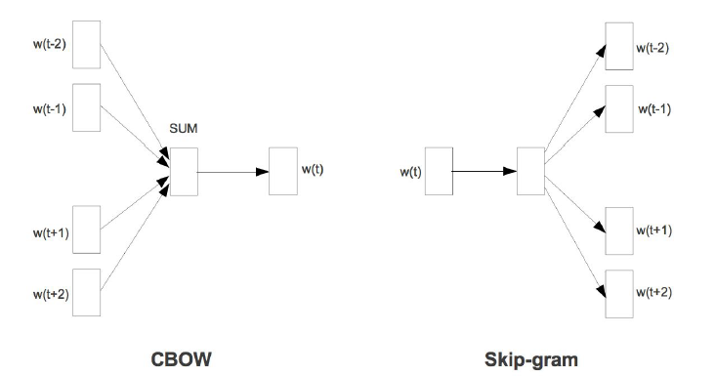
Word2Vec
There’re two flavors to Word2Vec
1. Skip-gram
2. Continuous bag-of-word (CBOW)

Slide 11
About the two models
1. CBOW
Predict the center word given the surrounding words
2. Skip-gram
Predict the surrounding words given the center word.

Slide 12
Language Model
Compute probability of the next word given the previous words.
Why do we have to care about LMs?
They’re used in a lot of NLP tasks from machine translation, text generation, speech recognition, and a lot more.

Slide 13
Language Models
1. Count-based Language Models
Apply fixed window size of the previous words to calculate probabilities of the upcoming words.
2. Neural Network Models
It may condition a word based on all of the previous words in a corpus. RNN is the most widely used model in this task.

Slide 14
Recurrent Neural Network (RNN)
In deep learning, all problems can be classified as:-
1. Fixed topological structure problems
e.g. Images …image classification
2. Sequential data problems
e.g. text/audio …speech recognition
RNN for sequential data.

Slide 15
RNN
In a normal feed forward network for making prediction, you need not any relation to previous outputs that has been classified.
Scenario:
While reading a book, you need to remember the context mentioned and what’s discussed in the entire book.
This is the case in sentiment analysis where algorithm need to remember the context of words before classifying document as Neg/Pos.

Slide 16
Why are RNN’s capable of such a task:-
1. Hidden states can store a lot of information and pass it on, effectively
2. Hidden states are updated by
nonlinear function.

Slide 17
Where do we find RNNs
1. Chatbots
2. Handwriting detection
3. Video and audio classification
4. Sentiment analysis
5. Time series analysis

Slide 18

Recurrence
Recurrent function is called at each time step to model temporal data.
Temporal data … depend on the previous units of data.
$x\left(t\right)=x\left(t−1\right)+b$

Slide 19
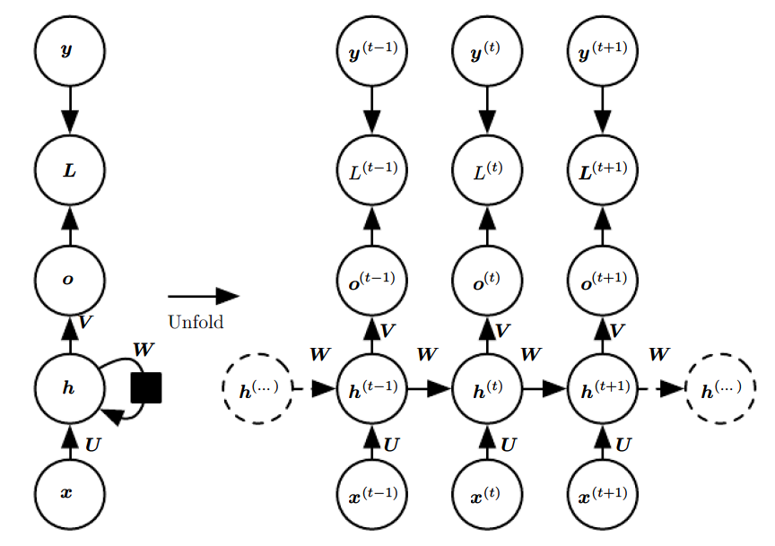

Slide 20

We first initialize initial hidden state
Then:-
For each time step:-
$a^{t}$ = U$x^{t} +$ W$h^{(t−1)}$ + b
$a^{t}$ -- activation at one time step

Slide 21

Then
$h^{t}$ $=tanh⁡(a^{t})$

Slide 22

Then after:-
$o^{t}$ = $Vh^{t}$ + c (bias)

Slide 23

Finally
${\hat{y}}^{t}$ = softmax($o^{t}$)

Slide 24
Our parameters are :-
b and c as well as U, V and W weight matrices
U for input-to-hidden connection
V for hidden-to-hidden connection
W for output-to-hidden connection

Slide 25
Note: That was example network
that maps input to output of the same length.

Slide 26
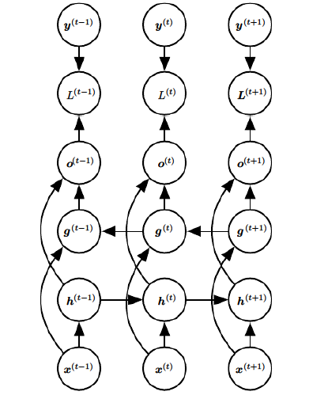
Bi-directional RNN

Slide 27
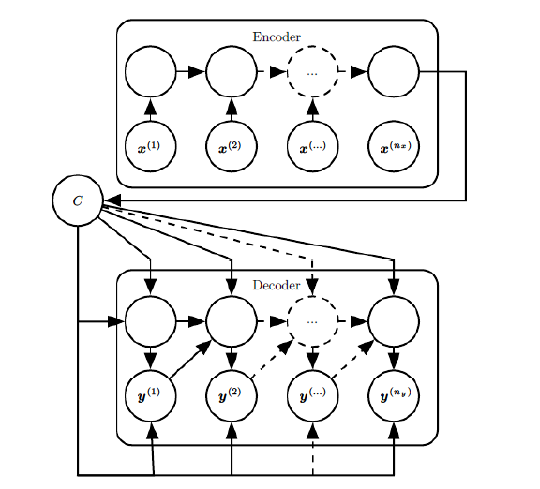
Neural Machine Translation (NMT)

Slide 28
Sentiment analysis
!

Slide 29
